Slide 1
What’s the point of applied health and social care research if it doesn’t have an impact?
From research to real-world change: impact through inclusion
Professor Stephen Peckham

Slide 2
What do we mean by research impact?
There are numerous definitions of impact but all refer to benefit including:
Influence on the research field (NIH)
  The likelihood for the project to exert a sustained, powerful influence on the research field(s) involved. (National Institutes of Health)
Benefit to society (NSF and REF)
  The potential [for your research] to benefit society and contribute to the achievement of desired society outcomes. (National Science Foundation)
  An effect on, change or benefit to the economy, society, culture, public policy or services, health, the environment or quality of life beyond academia. (UK Research Excellence Framework)
Benefit outcomes and processes (NIHR)
  Studies designed with real-world application in mind, focusing on solving specific, practical problems within health and social care settings. It aims to improve patient outcomes, enhance wellbeing, and directly inform local populations and care systems. (NIHR)

Slide 3

Why is thinking about impact important?
Accountability to funders and the public and demonstrating return on investment:
  In 2022 funding organisations spent just over £5 billion within the UK on health and care research.
Informing policy and practice and improving health and social care outcomes:
    Applied research engages with structures and processes – clinical or social work practice, policy development
    Improves outcomes
    Challenges or can confirm status quo
Ensuring impact is meaningful – considering both the quality and relevance of research.
    Research impact should reflect needs
    Impact is not subject to bias and gaps in knowledge
    Must be applicable to real-world populations
    Ensures trust between researchers and communities
    Supports fairer distribution of research benefits

Slide 4
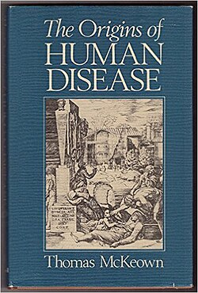
The growth of applied research for health
Concern that medicine (and specifically doctors) didn’t know best
Pre 1950:
  study in USA in 1920s: ‘always 40-50% of children need a tonsillectomy’
  in UK in 1930s (Alison Glover): unexplained geographical variation in rates
1970s reappraisal of role of medicine in decline of infectious diseases
  need for rigorous evidence of effectiveness - clinical trials (Archie Cochrane)
    epidemiology demonstrated that inexplicable geographical variations in use were widespread (John Wennberg & Dartmouth College)
    inappropriate use of common treatments (Bob Brook & RAND): lack of consensus about appropriate criteria for interventions
    increasing relevance of social science – medical sociology, economics, organisational research

Slide 5
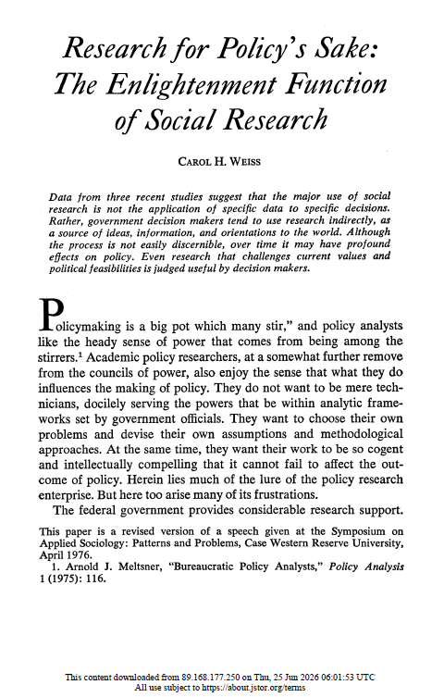
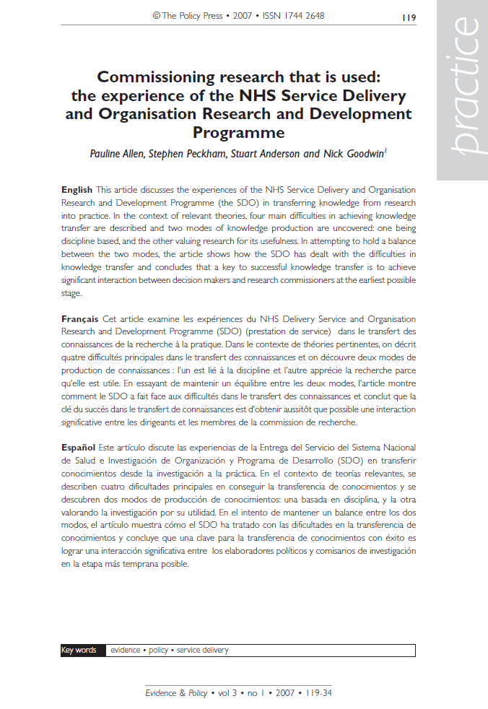
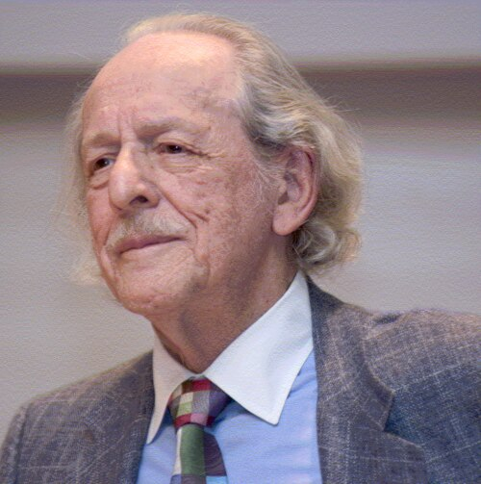
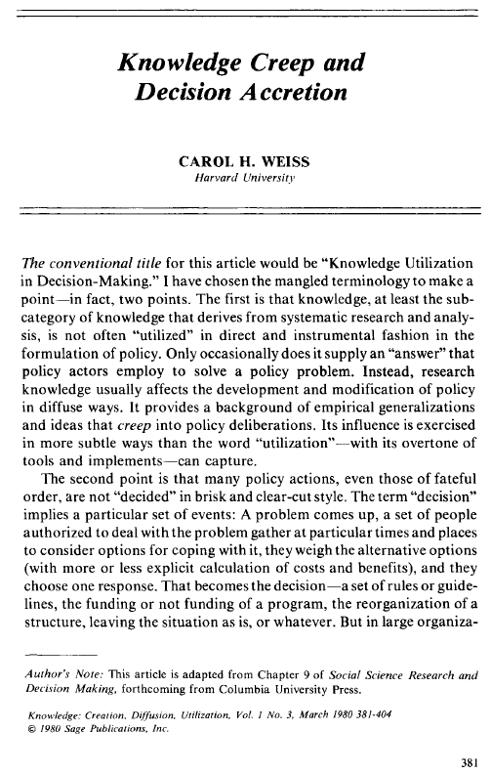
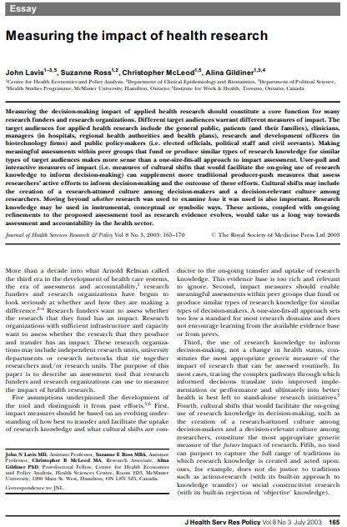
The growing interest in impact
Eugene Garfield: Institute for Scientific Information (ISI) Founded in 1956 producing citation indexing

Slide 6
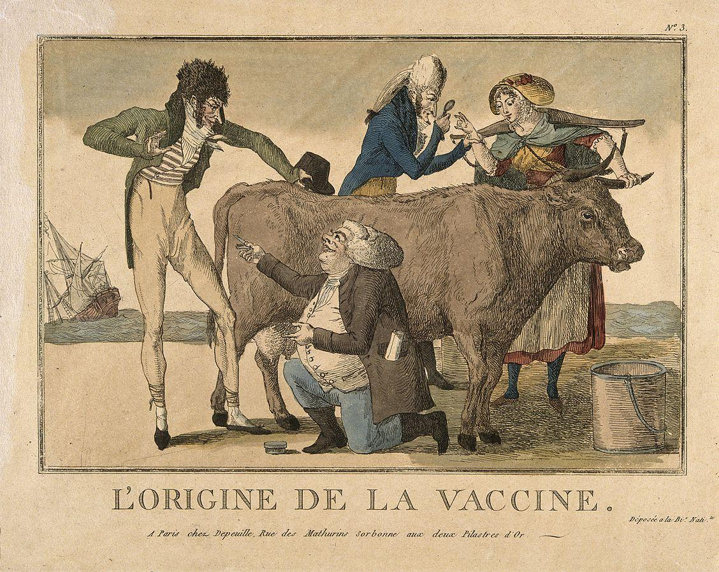
Conceptualising impact
  Edward Jenner is widely acknowledged as saving the most lives through small-pox vaccination starting with experiments with cow-pox in 1796
  Vaccination not widely introduced until 1840 – over 40 years later
But inoculation was widely used log before this:
    The concept of variolation had been used for centuries but involved using exposure to the live pathogen
    Introduced to UK in 1721 from Turkey
    In 1766 Daniel Bernoulli analysed smallpox morbidity and mortality data to demonstrate the efficacy of inoculation
    In 1768, the English physician John Fewster realised that prior infection with cowpox rendered a person immune to smallpox
  Smallpox vaccination – an evolution involving working with local people, experimentation and medical science leading to impact

Slide 7
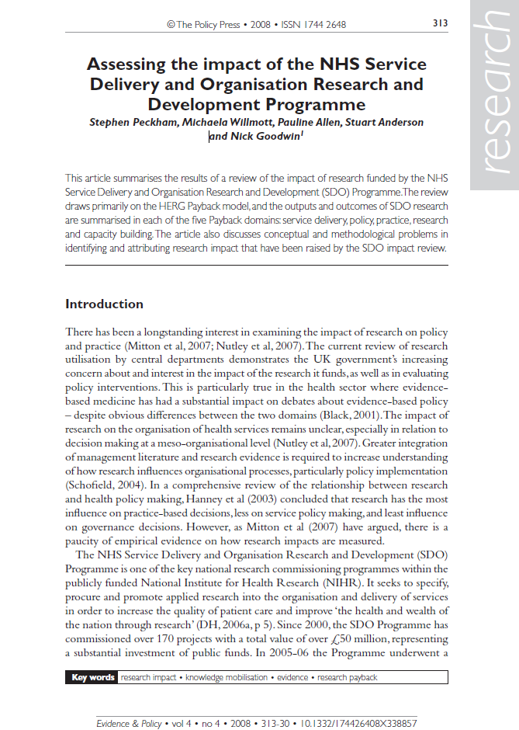

If impact is important how can we measure it?
Who should measure it?
  Funders –is funding used in the best way (ROI)
  Researchers – does their research have value
  Research users –is the evidence good and usable
  Wider public/society – is their benefit for those that need it
Impact includes change or benefit to:
  the activity, attitude, awareness, behaviour, capacity, opportunity, performance, policy, practice, process or understanding
  of an audience, beneficiary, community, constituency, organisation or individuals
  in any geographic location whether locally, regionally, nationally or internationally
  the reduction or prevention of harm, risk, cost or other negative effects.
Academic impact/research output
  Assessment of academic publications
  evaluates the rigorous, original, and significant research that underpins societal impact
There are competing interests and contested views about value

Slide 8
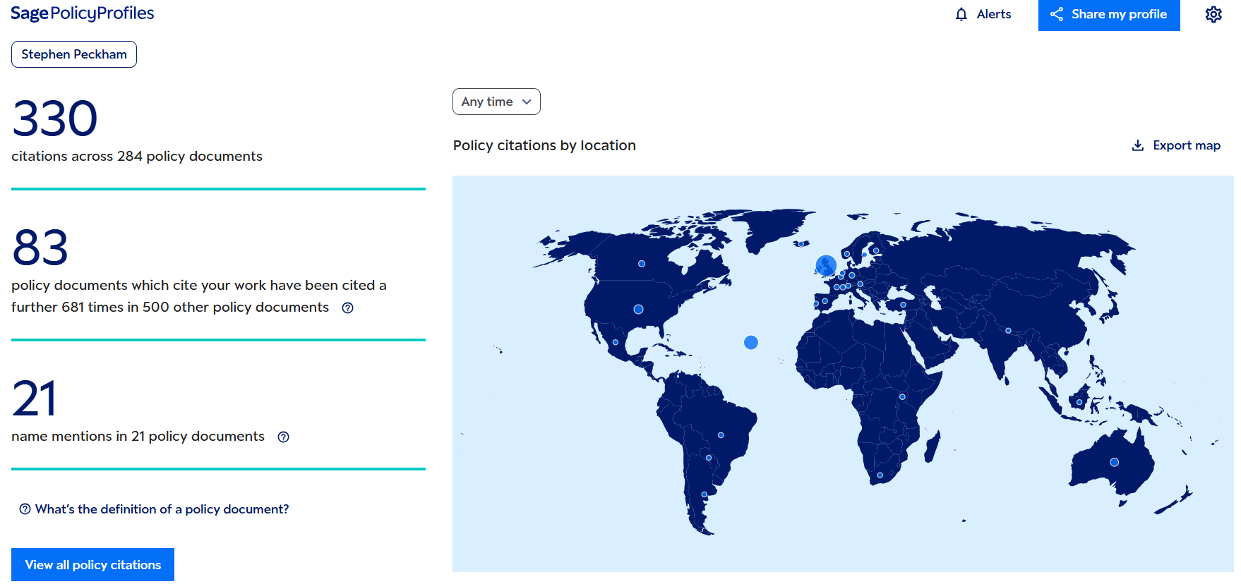
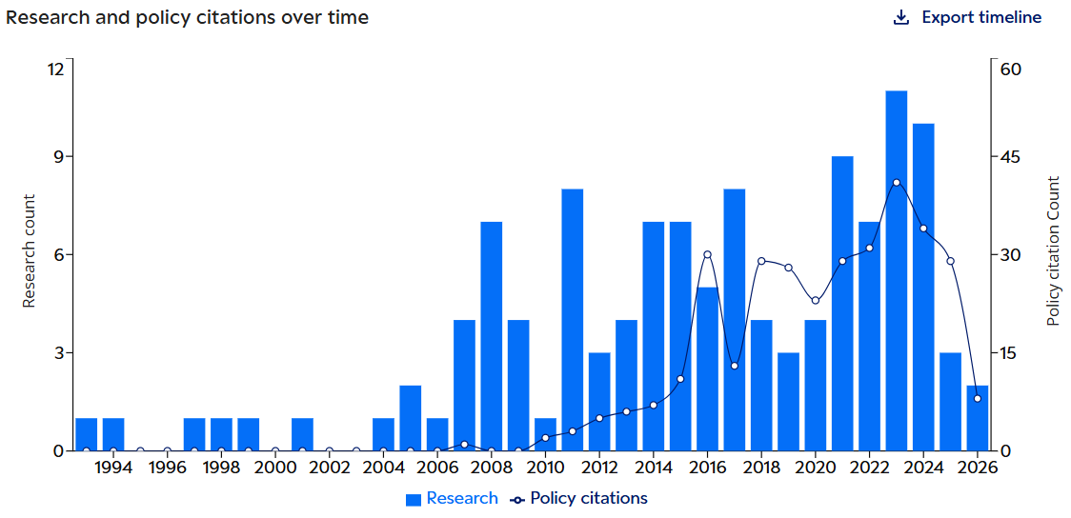
And what do we mean by impact?
Research is identified as being used in policy and guideline documents
Based on the ‘payback framework’ a positivist, linear model:
Research → Policy or practice
SAGE Policy Profiles: Pulls data from the OVERTON database https://policyprofiles.sagepub.com/dashboard

Slide 9
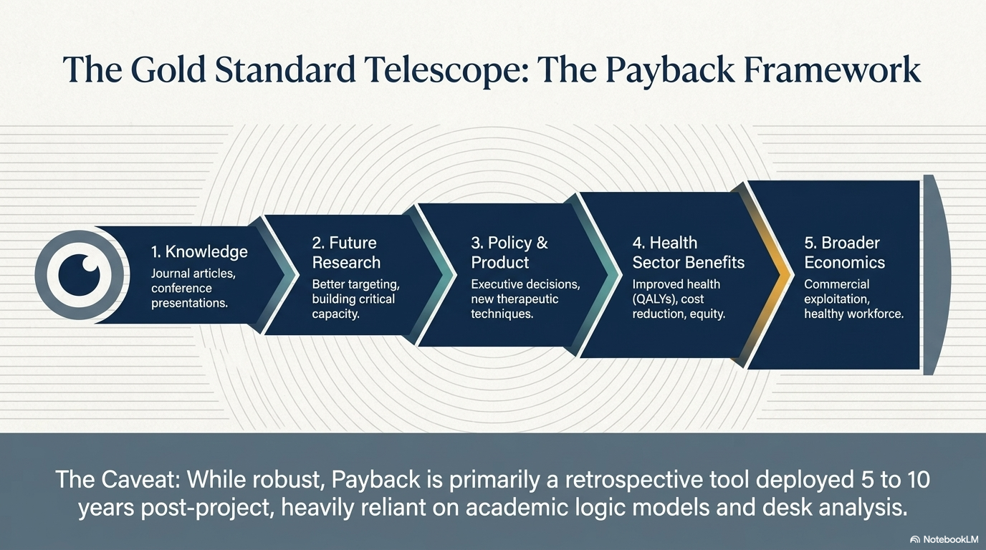
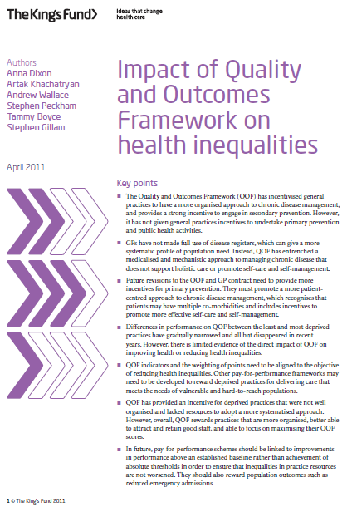
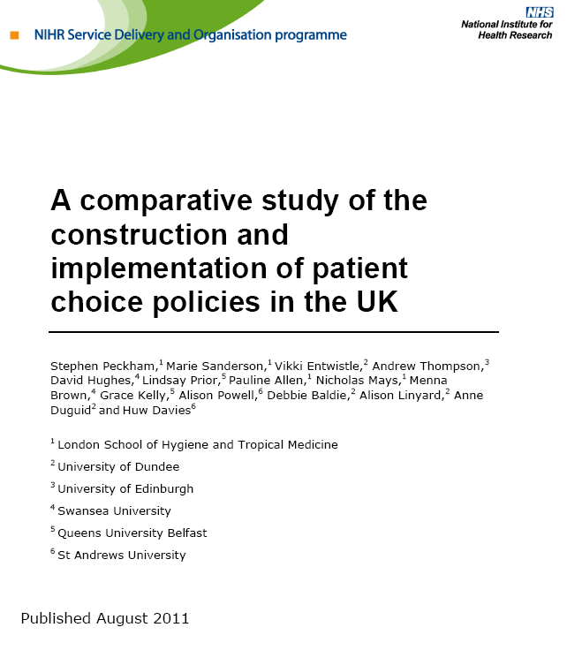
Measuring impact
If a scientific article is referenced, the reasoning goes, that research must have influenced policy but is this the right way to think about impact?
  a narrow interpretation
  misunderstands what impact is
  how do we tell

Slide 10
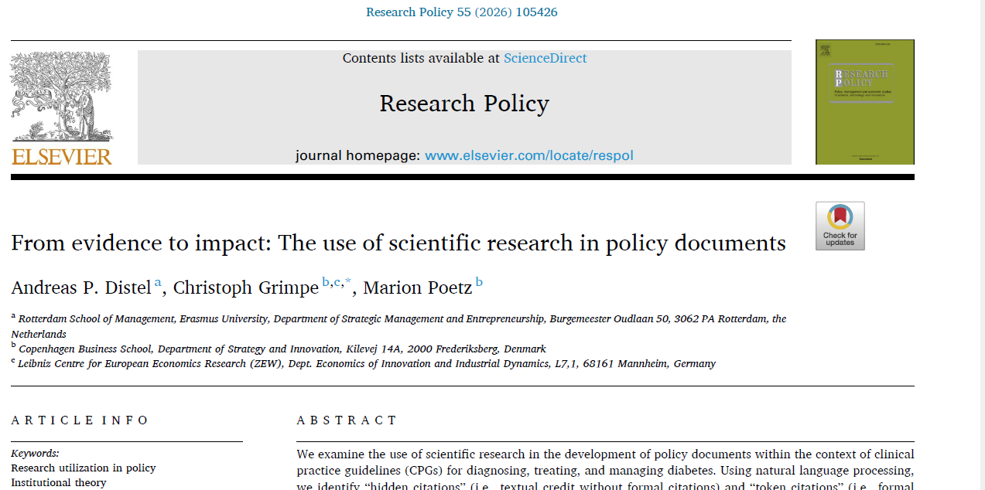
But is it as simple as that?
Citation and textual credit: Research is cited and clearly used in the policy text
Hidden citations: Research informs policy text but is not formally cited
Token citations: Research is cited but not meaningfully used in the text

Slide 11
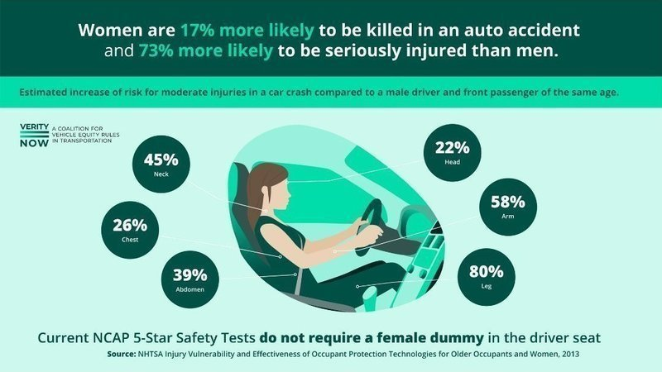
Why bias can affect impact
For decades assessment of injury was based on a scaled down version of a male crash dummy
The dummy sometimes used as a proxy for women is a scaled-down version of the male one, roughly the size of a 12-year-old girl.
Females seen as passengers not drivers
"You can see that this is a bias, … when all the men in the meetings decide, they tend to look to their feet and say 'this is it’. I would never say that anybody does it intentionally but it's just the mere fact that it's typically a male decision - and that's why we do not have [average] female dummies."
Sweden developed first anatomical female crash dummy just 3 years ago!!

Slide 12
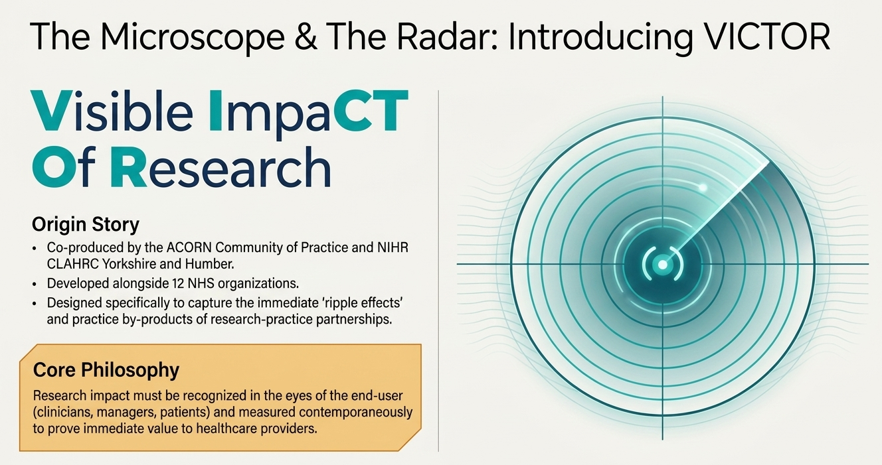
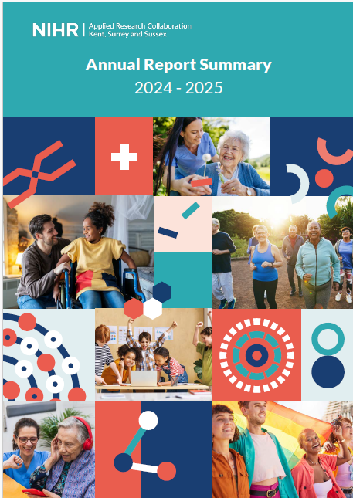
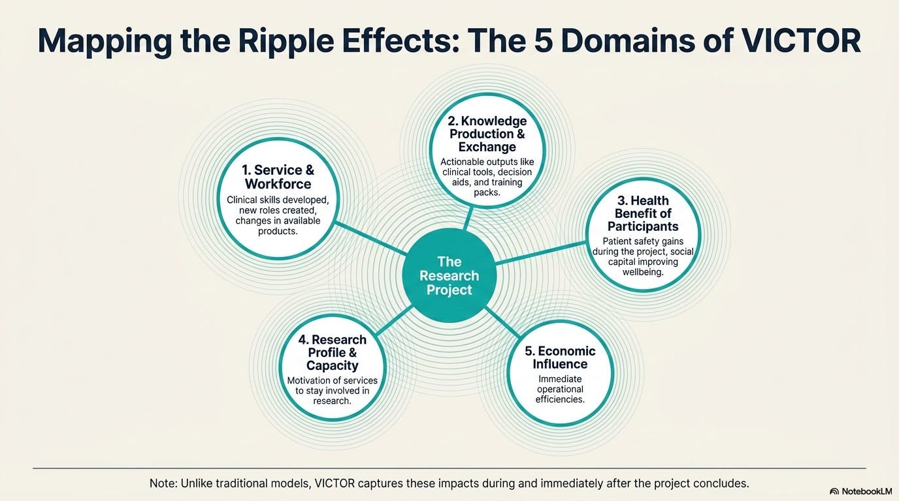
Reducing bias: rethinking research imapct
Considering research inclusion

Slide 13

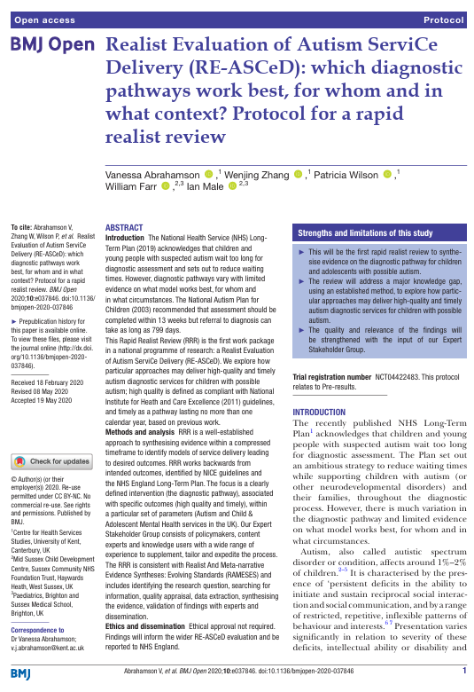
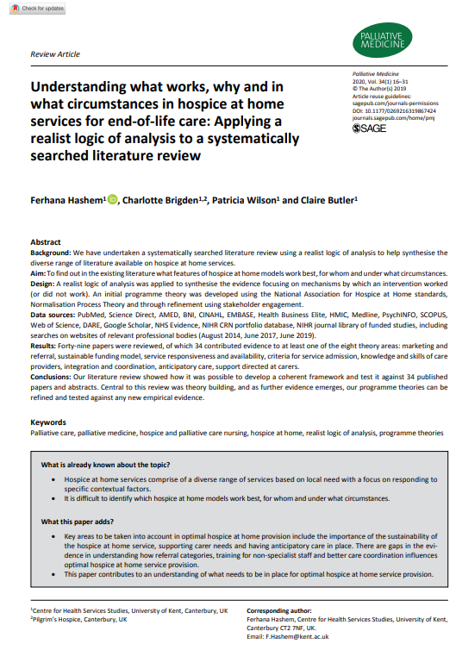
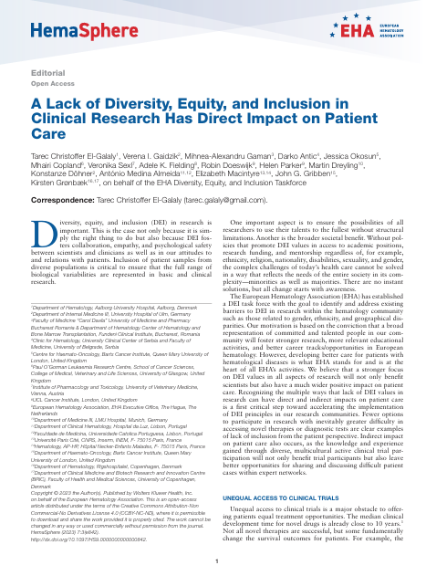
Search for new and more inclusive methodologies

Slide 14
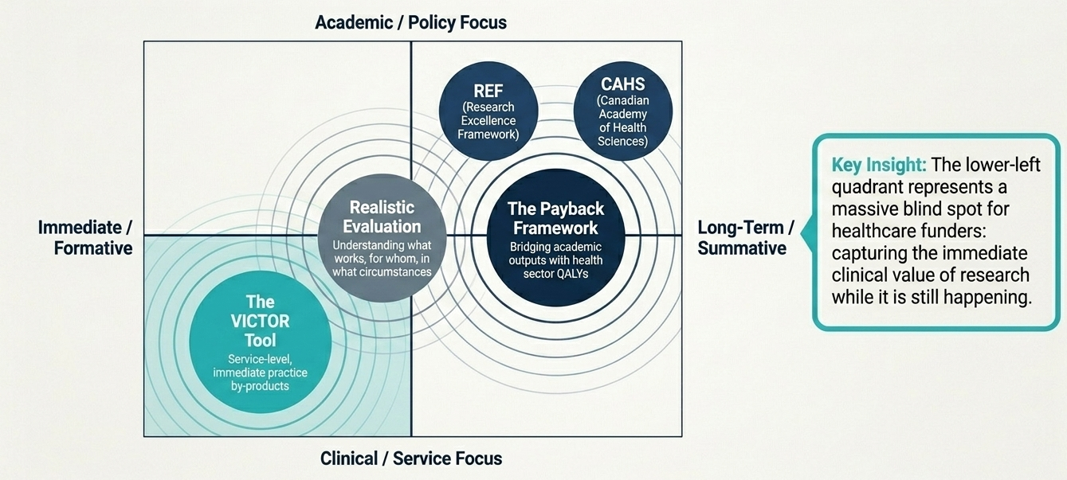
Expanding our approach to impact
Telescope
Microscope

Slide 15
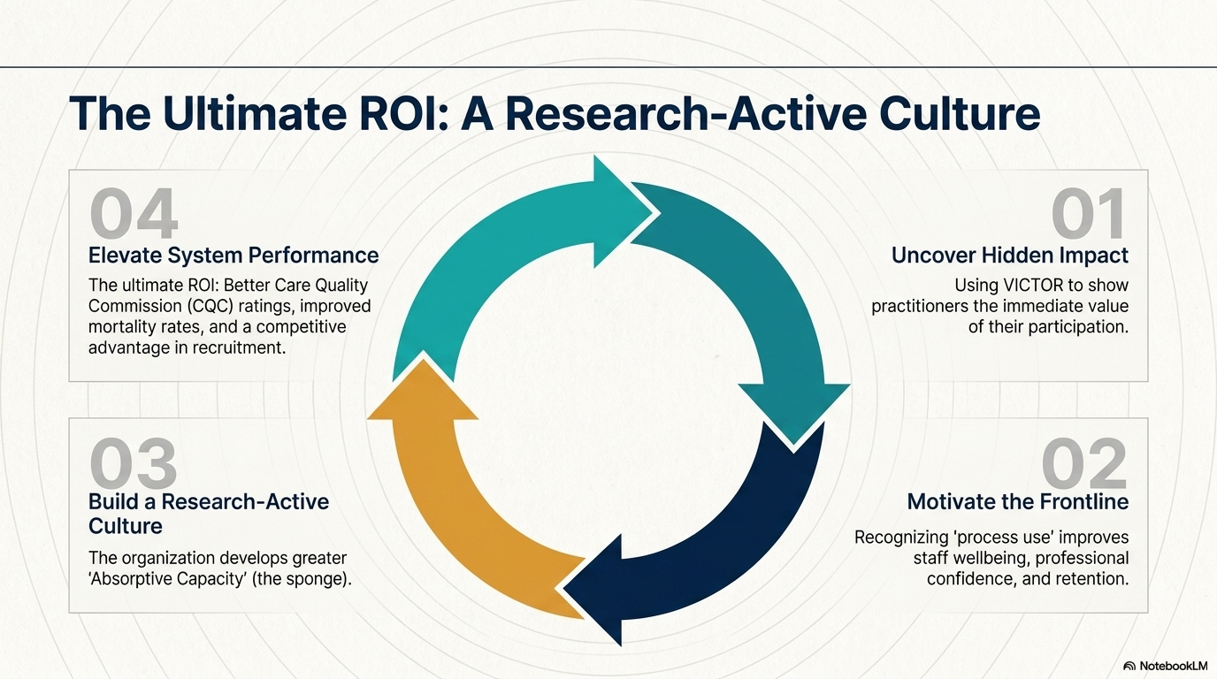
Impact in applied research – a culture issue
  Impact is the responsibility of funders, researchers and research users
  Impact is not linear and needs to involve producers and users
  Impact is as much dependent on the ability to use or absorb research findings as the ability to produce good research
  Impact is not easy to capture
  Greater inclusion supports better understanding of the question, better research and better impact

Slide 16
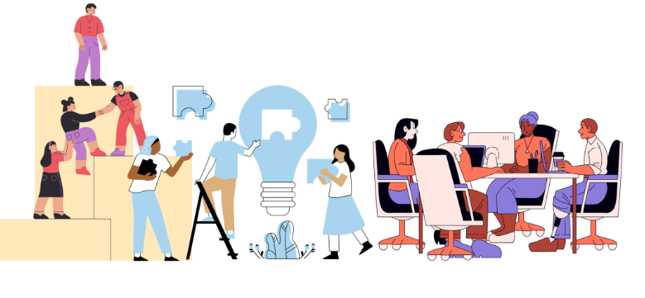
Why consider research inclusion?
Ensuring research is representative, accessible and equitable
  Ensuring diverse voices are represented
  Making research accessible and equitable
  Including underrepresented or marginalised people
  Considering diversity among both researchers and participants
Inclusion should not be an afterthought—it should run through the entire research lifecycle
    Research Question → Study Design → Recruitment → Data Collection
    Analysis → Dissemination → Impact
    Co-design research with communities
    Use accessible recruitment and communication methods

Slide 17
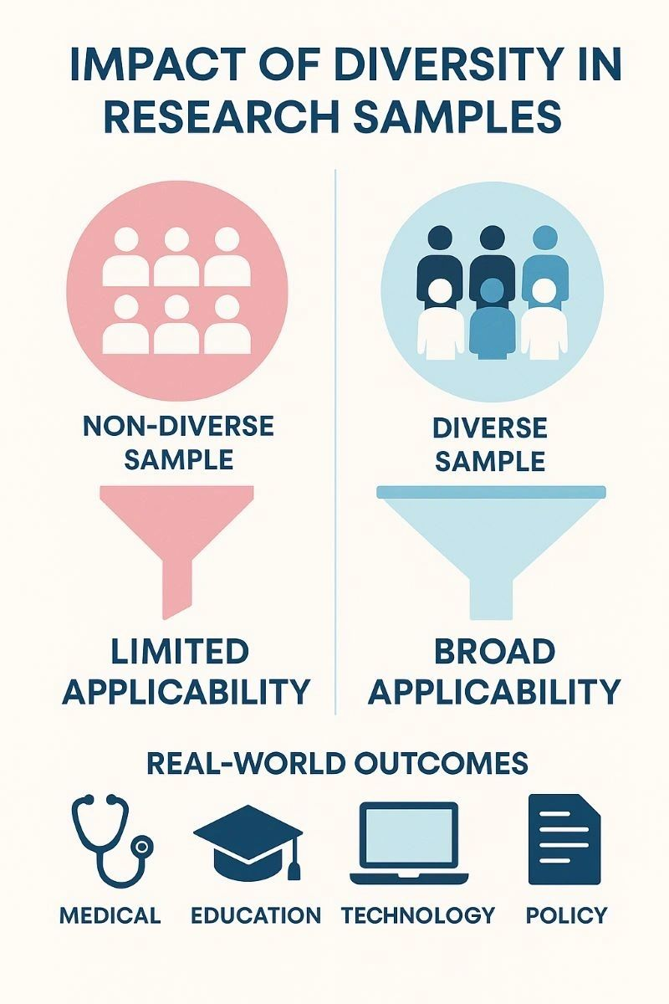
Barriers & Challenges
Recognising barriers is the first step towards addressing them.
Lack of diversity among researchers
Practical barriers to participation
Language and accessibility issues
Financial or geographical constraints
Institutional bias
Tokenistic rather than meaningful involvement

Slide 18
Key Takeaway
High-quality research goes beyond producing knowledge
Research should be relevant
Research should be accessible
Research should be inclusive
Research should create meaningful change
Impact and inclusion are strongest when considered together from the start

Slide 19
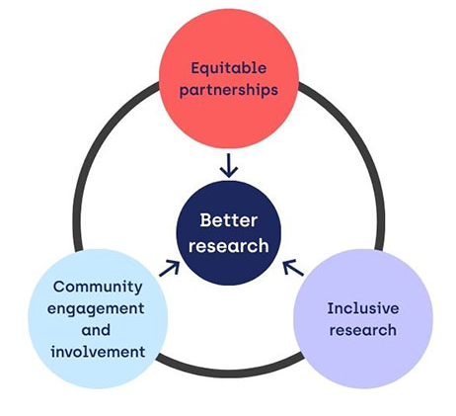
Taking steps
The Research Question:
Work with local communities and/or staff to co-produce questions. This stops researchers from asking questions that accidentally ignore certain groups.
Participant Recruitment:
Look past easy-to-reach groups.
Include underserved people by offering flexible appointment times, covering travel costs, and translating information clearly.
Analysis and Sharing:
Interpret findings with input from people who have lived experience of the topic to ensure recommendations are practical and fair.

Slide 20
Discussion & Call to Action
Questions for reflection
Who is included in our research—and who is missing?
How can we involve communities more meaningfully?
How do we ensure research benefits diverse populations?
What does meaningful impact look like?
What practical action can we take next?

Slide 21
Thank you
https://arc-kss.nihr.ac.uk/

