Slide 1

Have your say on support for adolescents and young adults (16-35) with severe mental health needs:
A James Lind Alliance priority setting partnership
Applied Research Collaboration Kent, Surrey, and Sussex Research Week 2026
Dr Devyn Glass
14th September 2026

Slide 2

Mental Health Innovation and Implementation Theme
Mental health transitions
Prevention
Mental health complexity/comorbidity
Severe Mental Ill-health/ psychosis
Interactions with physical health
Underserved populations
LGBTQ+
Early intervention
Schools/colleges/parenting
Depression/ anxiety
Minority ethnic groups
Neurodiversity
Migrants
Care leavers
Real World Implementation
Digital Interventions, Big Data…
Notes:
What the PSP gives us is a way of making sure that those research priorities aren't determined solely by researchers. We're asking young people, carers, families and professionals across Kent, Surrey and Sussex what questions they think research needs to answer. Those priorities can then feed directly into the Theme's future research programme, helping us identify where there are important gaps and where research could have the greatest relevance and impact.

Slide 3


James Lind Alliance Priority Setting Partnerships
What is a JLA-PSP?
A methodology to identify the top 10 research priorities on a specific healthcare topic through a collaborative and inclusive effort
Ensuring representation from patients, carers and health and social care professionals - funded by the NIHR Homepage | NIHR JLA
What are our regional (KSS) research priorities for adolescents/young adults (aged 16-35) in Secondary Mental Health Care?

Slide 4
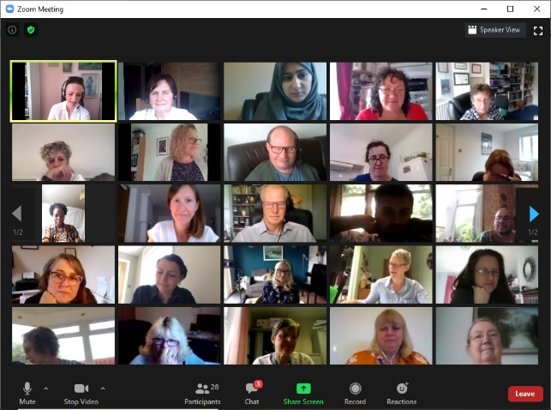
Why do we need JLA PSPs?
  There is a mismatch between what patients and health professionals want to see researched and the research that is funded and completed (Crowe et al., 2015).
  The JLA was created to address this mismatch.
  The PSPs give equal voice on the research agenda to people who haven’t usually had a say in what research is done.
Notes:
There is evidence that there is a mismatch between what patients and health professionals want to see researched and the research that is actually done. This can mean that research can fail to address questions that matter to patients and health professionals who need to make decisions every day. This is why the JLA process focuses on patients and clinicians. James Lind Alliance (JLA) Priority Setting Partnerships (PSPs) were created to address this mismatch – to give a voice in the research agenda to people who haven’t usually had a say in what research is done
This helps to make sure the right, most important questions are being addressed by research – a step on the pathway of making sure we get the most value out of research.

Slide 5

James Lind Alliance Priority Setting Partnerships
  Patients, carers, and health and social care professionals working as equals
  Focusing on a single condition or area of health and social care
  Identifying unanswered questions (evidence uncertainties)
  Prioritising the most important into a Top 10
  Promoting the Top 10 to researchers and funders

Slide 6





The JLA-PSP Process
1.Create a Steering Group
  With representation of patients/service users, carers/supporters, and health care professionals
  Agree PSP scope and publish a protocol
2.Gather
Uncertainties
  Launch a consultation phase
  Steering Group engagement with patients, carers and health care professionals
3.Summarise responses
4.Evidence Check
Form summary questions
Check existing evidence
5.Shortlisting Survey
6.Final Workshop
Reducing the long list of summary questions to a shorter list. Normally around 25 to be taken to the Final Workshop
7.Publish and Promote Top 10 research priorities
  Promote to researchers and funders
  Final report publication
  Long term tracking of Impact
  Apply for research funding

Slide 7
The JLA-PSP Process
1.Create a Steering Group
  With representation of patients/service users, carers/supporters, and health care professionals
  Agree PSP scope and publish a protocol
2.Gather
Uncertainties
  Launch a consultation phase
  Steering Group engagement with patients, carers and health care professionals
3.Summarise responses
4.Evidence Check
Form summary questions
Check existing evidence
5.Shortlisting Survey
6.Final Workshop
Reducing the long list of summary questions to a shorter list. Normally around 25 to be taken to the Final Workshop
7.Publish and Promote Top 10 research priorities
  Promote to researchers and funders
  Final report publication
  Long term tracking of Impact
  Apply for research funding

Slide 8
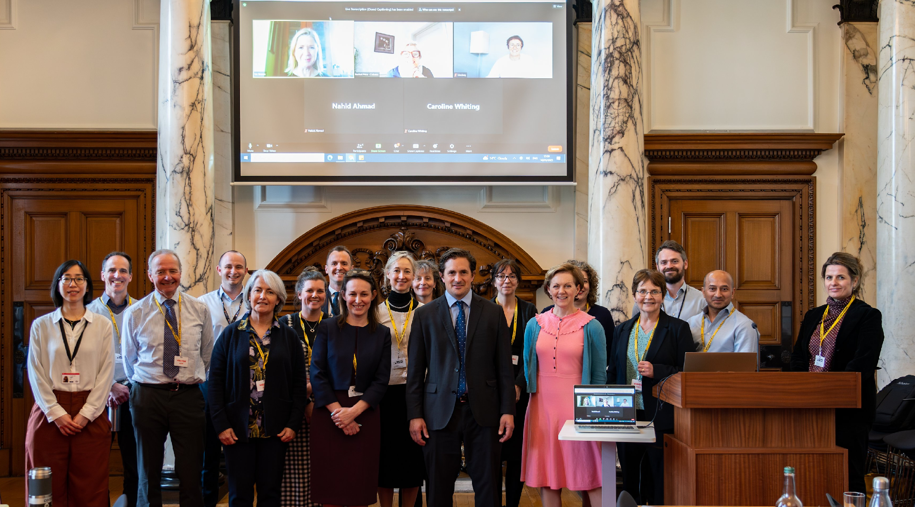
The Steering Group
Chaired by the JLA Adviser – a neutral facilitator
Made up of patient/service user, carer and health and social care professional representatives
Resources and expertise
  Setting and applying the scope
  Advise on appropriate languages
  Plan engagement strategies
  Publicising the project
  Overseeing the process
  Responsible for dissemination
Notes:
Advisor: The JLA Adviser’s role is to chair the PSP. They support and guide the PSP, as a neutral facilitator, ensuring that the process is followed in a fair, transparent way, with equal input from patients, carers, and healthcare professionals.
Adhering to JLA principles - Equal involvement, inclusivity, transparency of methods and of interests of the group (inc. exclusion of those who have commercial interests), commitment to using and contributing to the evidence base around a topic

Slide 9
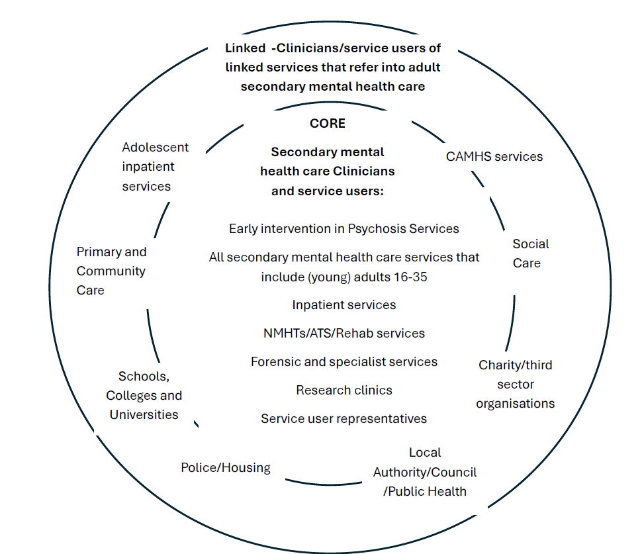







The KSS Severe Mental Ill-Health PSP Steering Group

Slide 10
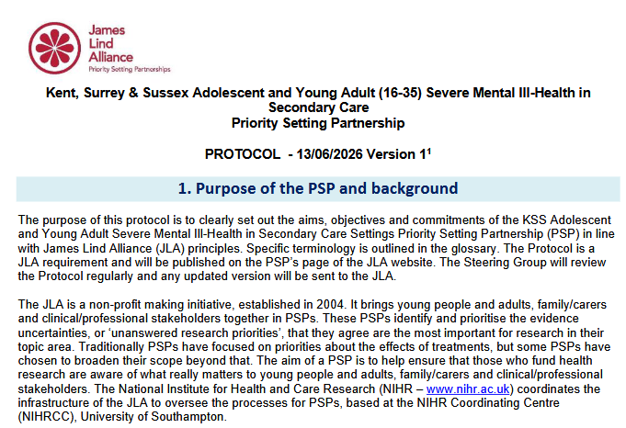
The KSS Severe Mental Ill-Health PSP Steering Group
The Steering Group is made up of 29 members:
7 are contributing from a lived experience perspective
2 are contributing from a dual- professional and lived experience perspective (PPI leads)
20 are professionals
  4 VCSE representatives
  3 LA representatives
  3 University representatives (2 researchers and 1 from wellbeing services)
  10 NHS representatives

Slide 11
The KSS Severe Mental Ill-Health PSP Scope
What are our regional (KSS) research priorities for adolescents/young adults (aged 16-35) in Secondary Mental Health Care?
Population
Adolescents/Adults aged 16-35 who have need of, are, or have been on a diagnostic pathway for Severe Mental Illness.
  Excludes those below 16 years of age – there is an existing JLA-PSP focussed on mental health in children and young people mental-health-in-children-and-young-people -top-10-priorities
  Excludes those above 35 years of age – as physical and mental health needs may differ in older people. This age cut-off was chosen as Early Intervention Services for SMI previously had an upper limit of 35. The majority of young people and adults develop a SMI before the age of 35.
Notes:
This includes people who have been offered or have received these services, but whose diagnosis changed or who did not receive a formal diagnosis, including people with an At-Risk Mental state, and people who do not agree with their diagnosis
and who also have other mental health conditions, physical conditions³, intellectual disabilities, neurodevelopmental or neurobehavioural conditions, substance misuse or addictions. This also includes adolescents/Adults who have need of, are or have been on a diagnostic pathway for Severe Mental Illness and have experience of being in care and/or have experienced domestic abuse or intimate partner violence.
For the purposes of this work SMI includes, but is not limited to, diagnostic pathways for Psychosis, Bipolar Disorder, OCD, Eating Disorders, Complex Trauma, Complex Emotional Needs, Severe Anxiety and Depressive conditions requiring secondary mental health care. The diagnostic pathway may include people with an At-Risk Mental State who have not received a diagnosis. Physical health conditions include but are not limited to respiratory, metabolic and cardiovascular diseases including diabetes, cancer.

Slide 12
The KSS Severe Mental Ill-Health PSP Scope
What are our regional (KSS) research priorities for adolescents/young adults (aged 16-35) in Secondary Mental Health Care?
Prevention and treatment
Treatments and approaches to care including the development and use of new types of treatments, that work on different underlying processes
  Based in secondary mental health care (AMHS and CAMHS) for the populations described, and for their families and carers.
  In services working closely with secondary mental health care.
  At points where people move between secondary care and other settings.
  Interventions delivered through co-working between non-NHS and secondary mental health care staff.
Notes:
Those working with secondary care may offer early support/prevention for people most at risk of developing serious mental health problems.
Transitions include from CAMHS to AMHS, discharge from inpatient wards, moving from crisis teams, and transitions between community teams.

Slide 13
The KSS Severe Mental Ill-Health PSP Scope
What are our regional (KSS) research priorities for adolescents/young adults (aged 16-35) in Secondary Mental Health Care?
Service delivery
The organisation and/or delivery of services in the settings described above, including customising treatments for different people and places, engagement with, and implementation of treatments.
  How to improve access to and experience of care, support, and treatments/approaches.
  Initiatives to improve care environments and support structures.
  Innovations, such as staff training and digital support.
  Personalisation of treatments.
  How people engage with treatment and how they are used in practice.

Slide 14
The JLA-PSP Process
1.Create a Steering Group
  With representation of patients/service users, carers/supporters, and health care professionals
  Agree PSP scope and publish a protocol
2.Gather
Uncertainties
  Launch a consultation phase
  Steering Group engagement with patients, carers and health care professionals
3.Summarise responses
4.Evidence Check
Form summary questions
Check existing evidence
5.Shortlisting Survey
6.Final Workshop
Reducing the long list of summary questions to a shorter list. Normally around 25 to be taken to the Final Workshop
7.Publish and Promote Top 10 research priorities
  Promote to researchers and funders
  Final report publication
  Long term tracking of Impact
  Apply for research funding

Slide 15

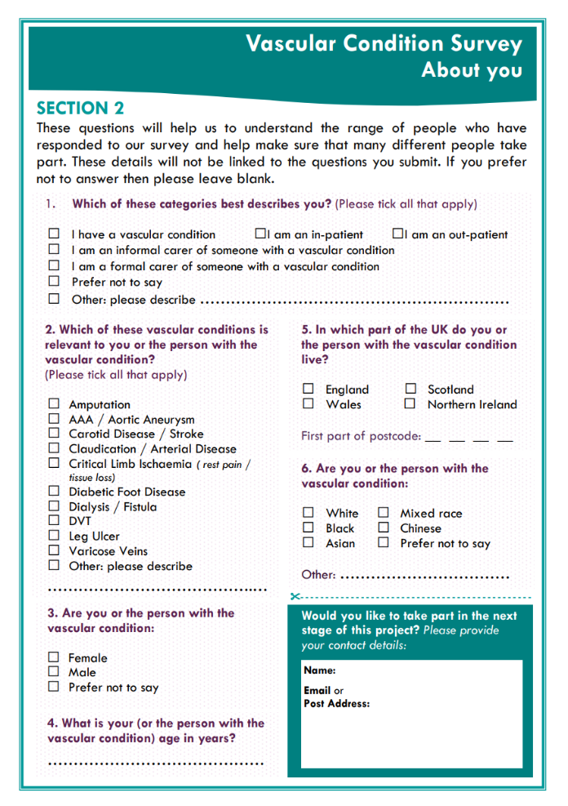
Gathering Uncertainties/ Initial Consultation
Evidence uncertainties exist where:
There are no up-to-date, reliable systematic reviews of research evidence addressing the research question
There are up-to-date systematic reviews of research evidence show that uncertainty exists.
Initial Consultation
  Seek the views of patients, carers, and health and social care professionals
    Open-ended questions asks people to respond with comments and questions based on their own experience
Notes:
Monitor who is responding, with only essential demographic information to ensure we are reaching subgroups of people accessing services, types of health and care professional, gender, geographical location etc.

Slide 16

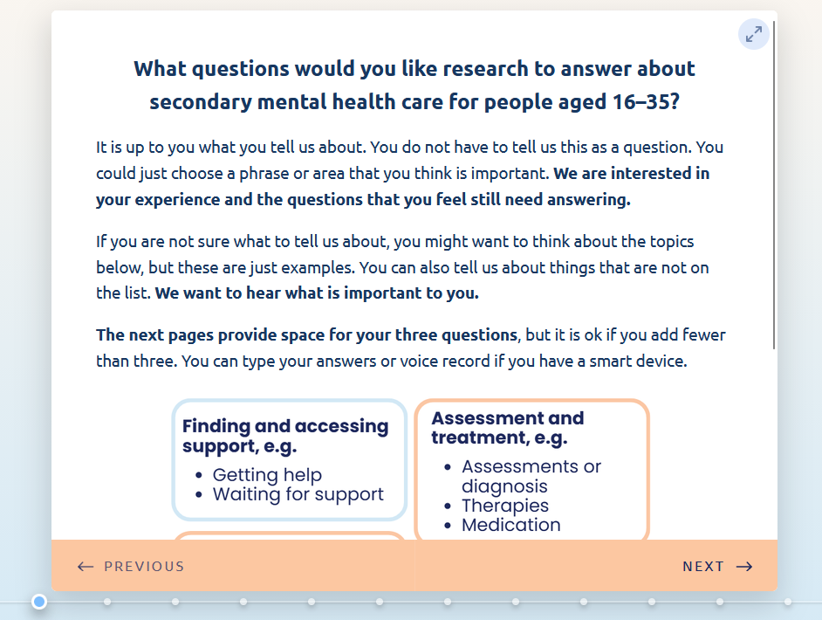

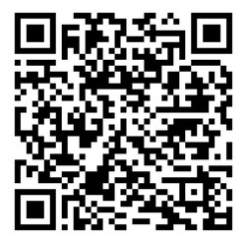
The KSS Severe Mental Ill-Health PSP Initial Consultation
Initial Consultation Survey Launch – THIS MONTH!
Help us identify organisations, individuals, and locations for us to advertise the survey
Notes:
https://pe.app/response_links/1fdb8093-fd80-44fb-944f-c50b7bf354eb/start
The Steering Group’s knowledge of the communities it represents will be crucial in designing an effective outreach strategy.
Check literature for research recommendations.

Slide 17
The JLA-PSP Process
1.Create a Steering Group
  With representation of patients/service users, carers/supporters, and health care professionals
  Agree PSP scope and publish a protocol
2.Gather
Uncertainties
  Launch a consultation phase
  Steering Group engagement with patients, carers and health care professionals
3.Summarise responses
4.Evidence Check
Form summary questions
Check existing evidence
5.Shortlisting Survey
6.Final Workshop
Reducing the long list of summary questions to a shorter list. Normally around 25 to be taken to the Final Workshop
7.Publish and Promote Top 10 research priorities
  Promote to researchers and funders
  Final report publication
  Long term tracking of Impact
  Apply for research funding

Slide 18
Forming Summary Questions/ Evidence Checking
This is not research! The aim is to summarise the responses ready for further public consultation.
Prepare the dataset (splitting narrative responses and coding)
Remove out-of-scope submissions, store/ decide how to deal with them
Categorise eligible submissions – thematic approach
Format submissions into summary questions
Prepare a ‘long-list’ (40-60 SQs)
Check the SQs from the long-list against existing evidence
Notes:
The consultation process will produce ‘raw’ questions and comments that people want answered by research. It is not about the numbers, it us about the questions, one question is given the same weighting as a theme or question proposed multiple times.
These raw questions will be categorised and refined into summary questions which are clear, addressable by research, and understandable to all.
Similar or duplicate questions will be combined where appropriate.
Out-of-scope and ‘answered’ submissions will be compiled separately.
The Steering Group will have review and have oversight of this process to ensure that the raw data is being interpreted appropriately and that the summary questions are being worded in a way that is understandable to all audiences. The JLA Adviser will observe to ensure accountability and transparency.
This will result in a long list of in-scope summary questions. These are not research questions and to try and word them as such may make them too technical for a non-research audience. They will be framed as researchable questions that capture the themes and topics that people have suggested.

Slide 19
The JLA-PSP Process
1.Create a Steering Group
  With representation of patients/service users, carers/supporters, and health care professionals
  Agree PSP scope and publish a protocol
2.Gather
Uncertainties
  Launch a consultation phase
  Steering Group engagement with patients, carers and health care professionals
3.Summarise responses
4.Evidence Check
Form summary questions
Check existing evidence
5.Shortlisting Survey
6.Final Workshop
Reducing the long list of summary questions to a shorter list. Normally around 25 to be taken to the Final Workshop
7.Publish and Promote Top 10 research priorities
  Promote to researchers and funders
  Final report publication
  Long term tracking of Impact
  Apply for research funding

Slide 20
Shortlisting the Priorities
Interim prioritisation stage:
Additional public consultation to move from a long list of unanswered questions, to a short list
The long-list is included in a shortlisting survey and disseminated using a similar process to the first survey
Final prioritisation stage:
Ask patients, carers and health and social care professionals to vote on the most important questions in their experience
Conducted during a one-day workshop facilitated by the JLA

Slide 21
The JLA-PSP Process
1.Create a Steering Group
  With representation of patients/service users, carers/supporters, and health care professionals
  Agree PSP scope and publish a protocol
2.Gather
Uncertainties
  Launch a consultation phase
  Steering Group engagement with patients, carers and health care professionals
3.Summarise responses
4.Evidence Check
Form summary questions
Check existing evidence
5.Shortlisting Survey
6.Final Workshop
Reducing the long list of summary questions to a shorter list. Normally around 25 to be taken to the Final Workshop
7.Publish and Promote Top 10 research priorities
  Promote to researchers and funders
  Final report publication
  Long term tracking of Impact
  Apply for research funding

Slide 22

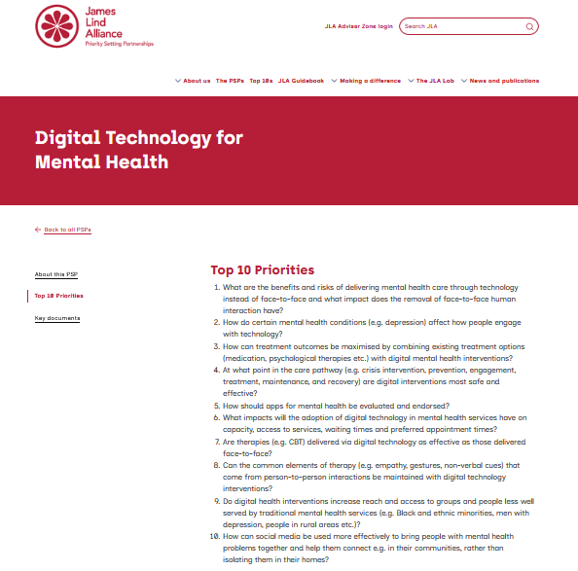
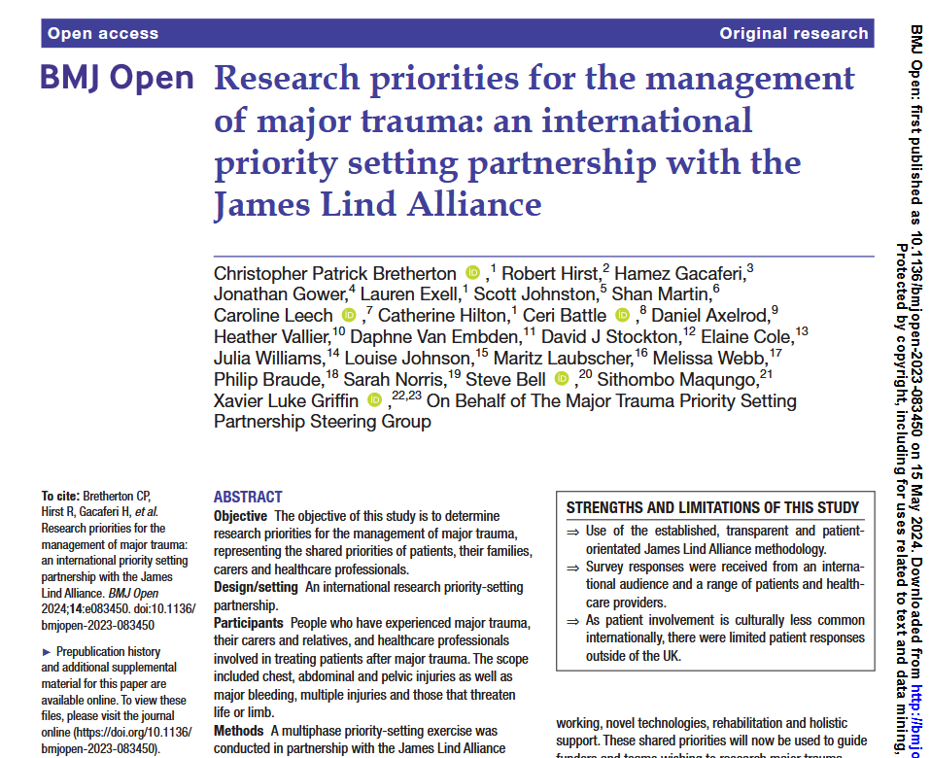
Publishing the Research Priorities

Slide 23
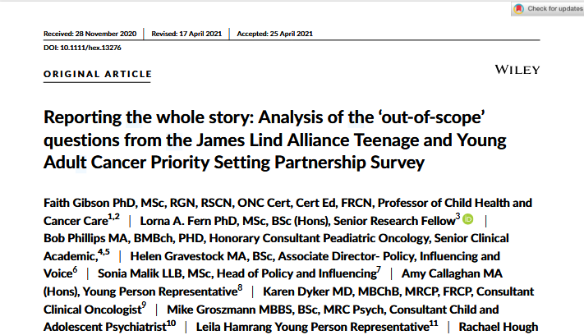
Publishing the Research Priorities

Slide 24
Next steps…
Invite us to your services to disseminate the survey
Suggest locations and contacts for survey dissemination
Complete and share the survey – look out for the launch next week
Get in touch to stay up to date, get involved in the next stages of the PSP, and hear more from the Mental Health theme
(ARC-KSS-MH@sussex.ac.uk)

Slide 25
PSPs Making a Difference
“I then learned of the opportunity to participate in the UK Epilepsy PSP Workshop and felt that I could add huge value by not only representing other parents like myself, but by giving my little girl a voice.”
Parent involved in the Epilepsy UK PSP

Slide 26
PSPs Making a Difference
“This has changed how I practice medicine. It has changed my understanding of what it means to listen to patients. It has changed the language I use when I speak with them. Most importantly it has changed my vision of how to deliver the care we give them. It has made it our vision.”
Noémi Roy, Rare Inherited Anaemias Priority Setting Partnership

Slide 27
Arc-kss-mh@sussex.ac.uk

