Slide 1

Health and Care Professional (HCP) Internships
Cohort 2 2026-7
Dr Julie Macinnes and Beth Flowers
14/7/26

Slide 2
What is the HCP Internship Programme all about?
The HCP Internship Programme provides funding and support for health and social care professionals to advance their knowledge and skills in research
It is aimed at professionals from a wide range of backgrounds and with a wide range of career aspirations
The internships provide flexible and individually tailored programmes of learning designed to meet the needs and aspirations of each intern providing individuals with a strong foundation on which to build a research related career

Slide 3
Who is the programme delivered by?
The programme is funded by the National Institute of Health and Care Research (NIHR)
In our region, it is delivered by the NIHR Applied Research Collaboration, Kent, Surrey and Sussex (NIHR ARC KSS) and partners including NHS Trusts, Universities and other organisations including the Research Delivery Network and the Health Innovation Network, together with Public Advisors

Slide 4
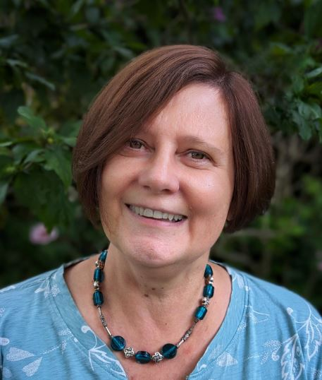


Meet the ARC KSS Academy Team
Dr Julie MacInnes
Beth Flowers
Theresa Gadsby-Bourner
Research Capacity and Academic Career Development Lead
Academy Manager
Academy Facilitator
INSIGHTS 2026
Dr Julie MacInnes Beth Flowers Theresa Gadsby-Bourner
Research Capacity Academy Manager Academy Building Lead Facilitator

Slide 5
Who can apply for an internship?
You must be a registered Health or Care Professional from this NIHR list:
The Programme excludes Doctors and Dentists
Academy for Healthcare Science
General Chiropractic Council
General Optical Council
General Dental Council
General Medical Council
General Osteopathic Council
General Pharmaceutical Council
Health and Care Professions Council
Nursing and Midwifery Council
Social Work England
UK Public Health Register

Slide 6
Who can apply for an internship?
In addition:
You must be at a pre-doctoral stage of your career i.e. you do not have a PhD or an equivalent doctoral level qualification in research
You must work in Kent, Surrey or Sussex (other regions have similar programmes)

Slide 7
I have no experience in research - is the internship for me?
Yes!
The internships are for those with little or no research knowledge, skills or experience, right through to those aspiring to clinical/Practitioner academic careers
….we are also keen to receive applications from those working in settings such as primary and community care, local authorities, social care and research delivery

Slide 8
How long is the internship and what funding is available?
33 internships will be offered every year for the next 2 years
10 places are ‘ring-fenced’ for radiographers and pharmacists
Each internship lasts up to 9 months
Up to £10,000 is offered per internship, plus £700 for your employing organisation (or the organisation where you will be undertaking your internship) towards administration costs and mentorship
You will be asked to provide some basic costings for your internship – contact the ARC KSS Academy for help with this

Slide 9
There are 4 levels or types of internship
Stepping into Research: For those in clinical, practitioner or other roles with little or no research experience but who want to take the first step into research to learn about ways to engage with research to improve professional practice and embed research in care
Growing in Research: For those in enhanced or advanced roles who want to develop the research pillar of their role and/or to develop team research culture and confidence

Slide 10
There are 4 levels or types of internship
Delivery leadership in Research: For those in (or aspiring to) research delivery roles who want to extend their research delivery skills, improve research delivery practice and leadership, and/or gain experience in wider aspects of the research process
Clinician or Practitioner academic leadership in Research: For those aspiring clinical academics who want to develop their research knowledge and skills to lay foundations for future funding awards

Slide 11
What can I do as part of the internship?
We anticipate that you may not have a clear vision about how to develop your ideas for an internship or what is available, therefore we have developed a ‘menu’ of opportunities to choose from (see the Application Form)
This menu is not meant to be prescriptive or exhaustive but is designed to stimulate ideas and open-up possibilities to advance research careers at all levels

Slide 12
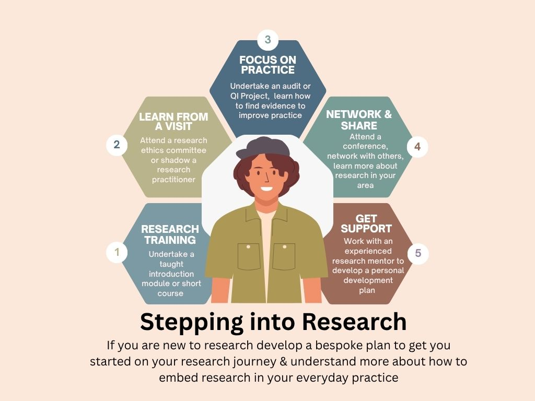

Slide 13
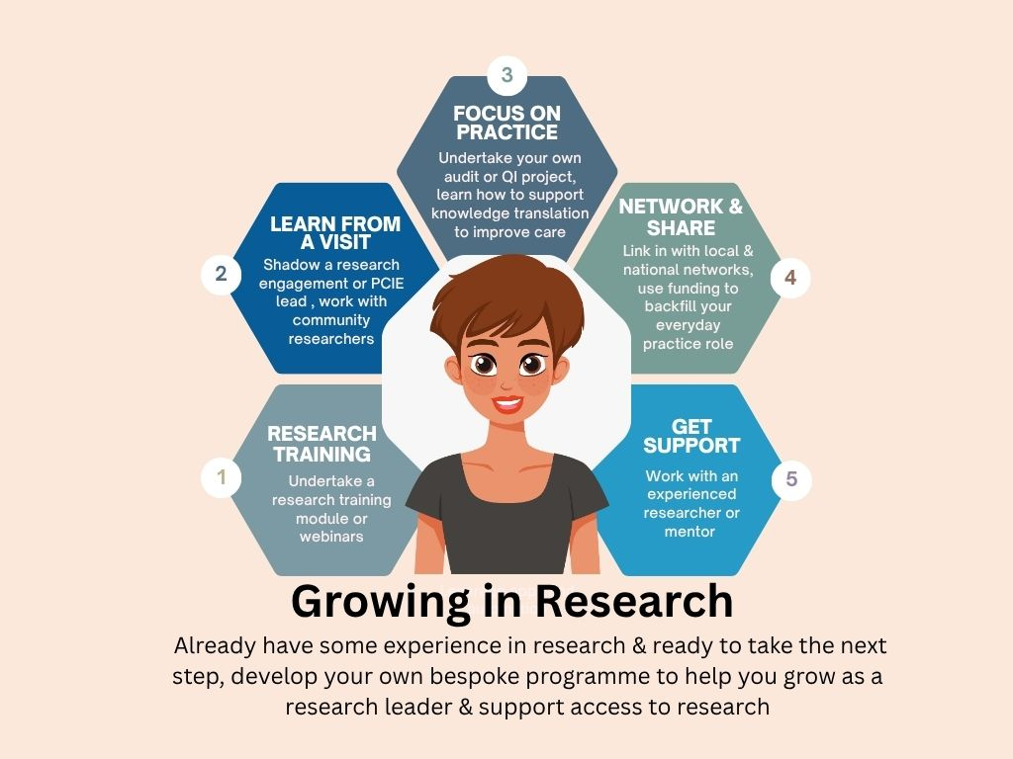

Slide 14


Slide 15
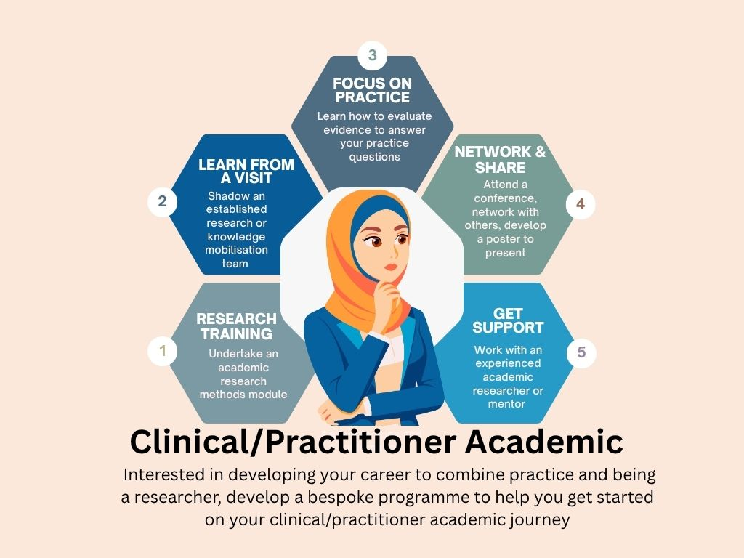

Slide 16
What help and support will I receive during my internship? Mentorship
As part of the internship you will be supported by a mentor
A mentor is normally an experienced professional who can guide and support you in developing your skills and knowledge. They may provide advice, career guidance, and opportunities to develop research ideas, for example
If you already have a mentor in mind, please indicate this in the application form
If you do not have a workplace mentor, ARC KSS and partners will be able to help you find one

Slide 17
What help and support will I receive during my internship?
Academic Supervision
If you are undertaking an academic module/course as part of your internship, academic support will normally be provided by the University or institution delivering that module/course.
ARC KSS can also link you with an academic supervisor, if you need one (this is funded separately and is not part of the £10,000)

Slide 18
What help and support will I receive during my internship?
Peer support
ARC KSS and partners will bring together all interns, online, every other month so you can share successes and challenges and seek further support
Near the end of the internship ARC KSS and partners will host an online Celebration Event so you can share your experiences and support the next cohort of interns

Slide 19
What are the timelines?
Submit your application by 5pm 30th September 2026, to
arckssacademy@kent.ac.uk
You will receive a decision within 8 weeks of the application deadline. If successful, you may be asked to address any specific queries relating to your application, with the support of the ARC KSS team.
The start date for the internship will be 1st February 2027
The internship must finish by 31st October 2027

Slide 20
How do I apply?
To apply you need to complete the Application Form and send this to:
arckssacademy@kent.ac.uk
Please make sure you refer to the Guidance for Applicants which describes in detail what is needed for each section
You must provide all the information requested on the application form using clear and concise language with minimal use of technical jargon
Application form link
jj

Slide 21
Who do I contact if I need help with my application or have any questions?
If you need help with the application, please contact the ARC KSS Academy team in the first instance:
You will then be given a named contact within ARC KSS or one of our programme partners who will be pleased to provide you with support and guidance

Slide 22
What happens after I apply?
An assessment panel, which includes public members, will meet to discuss all applications. The panel will assess:
Personal strengths: Does this application present a good opportunity to support a career trajectory for someone who is building or becoming involved in research?
Objectives: How appropriate are the proposed activities and plans for skills development? Are activities clearly explained and appropriate? Is the timeline achievable?
Sharing learning: Are there clear plans to share the skills and knowledge gained during the internship within organisation(s) or more widely?
PCIE and Inclusivity: Are there plans to include patient, public or community involvement and engagement (where relevant)? Does the internship promote inclusivity?
njj

Slide 23
Why are you asking me for equality, diversity and inclusivity information?
We are committed to promoting equality, diversity and inclusivity
After submitting your application, you will be asked to complete an online EDI questionnaire.
We encourage you to complete this so that ARC KSS can monitor and ensure our funding opportunities and activities are unbiased and inclusive.
This information will be collected anonymously and will not be shared during the assessment process.

Slide 24
A note about agreement (‘contract’)
Once you have accepted your place on the internship programme, there will need to be an agreement between your employer and the programme team (Sussex Partnership NHS Foundation Trust, SPFT)
This is why we ask you to provide the contact details of someone who has oversight of research or finance at your organisation who will be our contact for arranging the agreement (‘contract’).
This process will take place before you start the internship

Slide 25
What are my next steps if I want to apply?
1
Check you are eligible
4
5
Prepare your application, making sure you refer to the Guidance for Applicants document
i.e profession, level (pre-doctoral), KSS
Think about the activities you might undertake as part of the internship
2
3
e.g manager, mentor, R&I or other (finance) contact
Identify who you will need to support you and discuss the internship opportunity with them
Think about which of the 4 levels of internship best describes you research experience
Stepping into research; Growing in research; Delivery research leadership; Clinical/practitioner academic
See the ‘menu’ for examples but also add your own ideas
Contact the ARC KSS Academy for 1-2-1 support or if you have any questions

Slide 26
Thank you!

